Slide 1
NET. 012
S.O.L.I.D. (cont.)
Class 13
Notes:
©2019 John Hinz

Slide 2
Agenda
Continue S.O.L.I.D discussion
Interface Segregation
Dependency Inversion
Notes:
Section Start Slide

Slide 3
The Interface Segregation Principle - Defined
The Interface Segregation Principle states:
Clients should not be forced to depend on (implement) methods they do not use.
Prefer small, cohesive interfaces to ‘fat’ interfaces

Slide 4
The Interface Segregation Principle
Interface Segregation violations result in classes that depend on things they do not need, increasing coupling and reducing flexibility and maintainability.
Keep interfaces lean and focused
Refactor large interfaces so they inherit smaller interfaces

Slide 5
Interface Segregation Principal
Keep interfaces small, cohesive, and focused
Whenever possible, let the client define the interface
Whenever possible, package the interface with the client

Slide 6
Interface Segregation Principal
Before
https://dotnetfiddle.net/Vo9zhP
After
https://dotnetfiddle.net/6bzaD8

Slide 7
The Dependency Inversion Principle
High-level modules should not depend on low-level modules. Both should depend on abstractions.
Abstractions should not depend on details. Details should depend on abstractions.

Slide 8
Traditional Programming Dependencies
High Level Modules Call Low Level Modules
User Interface depends on
Business Logic depends on
Infrastructure
Utility
Data Access
Class instantiation / Call stack logic is scattered through all modules
Violation of Single Responsibility Principle

Slide 9
Dependency Injection
Dependency Injection is a technique that is used to allow calling code to inject the dependencies into a class when needed.
Three Primary Techniques
Constructor Injection
Property Injection
Parameter Injection

Slide 10
Constructor Injection
Dependencies are passed in via constructor
Pros
Classes self-document what they need to perform their work
Classes are always in a valid state once constructed
Cons
Constructors can have many parameters
Some methods in the class may not require things other methods require
https://dotnetfiddle.net/evnUkC

Slide 11
Property Injection
Dependencies are passed in via a property
Also known as “setter injection”
Pros
Dependency can be changed at any time during object lifetime
Very flexible
Cons
Objects may be in an invalid state between construction and setting of dependencies via setters
https://dotnetfiddle.net/YAmKsR

Slide 12
Parameter Injection
Dependencies are passed in via a method parameter
Pros
Most granular
Very flexible
Requires no change to the rest of the class
Cons
Can result in many parameters
https://dotnetfiddle.net/Zaaddm

Slide 13
When to use Dependency Injection
Use of the ‘new’ keyword
If you are creating many class instances inside a single class that container class may be a good candidate for dependency injection.
Use of static methods / properties
If your class makes use of many static methods it may be a good candidate for dependency injection

Slide 14
Where do we instantiate objects?
Default Constructor
You can provide a default constructor that new[s] up the instances you expect to typically need in your application
Referred to as “poor man’s dependency injection” or “poor man’s IoC”
Main
You can manually instantiate whatever is needed in your application’s startup routine or main() method
IoC Container
Use an “Inversion of Control” Container

Slide 15
IoC Containers
Initiated at application start up via code or configuration
Managed interfaces and the implementation to be used are registered with the container
Dependencies on interfaces are Resolved at application start up or runtime
Examples of IoC Containers for .NET
Microsoft Unity, StructureMap, Ninject, Windsor

Slide 16
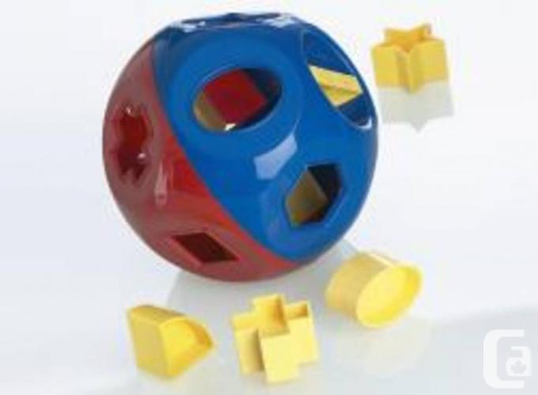
In-Class Assignment
Take the code in the fiddle below and apply the SOLID principals to refactor the code:
https://dotnetfiddle.net/r0K2GM

Slide 17
THANK YOU.
Notes:
Sign Off Slide

